Slide 1
Team 20 Robotics PLC Lab Trainer
Brandon Lim, Kelton McGrath, Gavin Sueltz, Shey Dilloway, Anthony Russo
Dr. Yongzhi Qu
Quinton Christensen

Slide 2
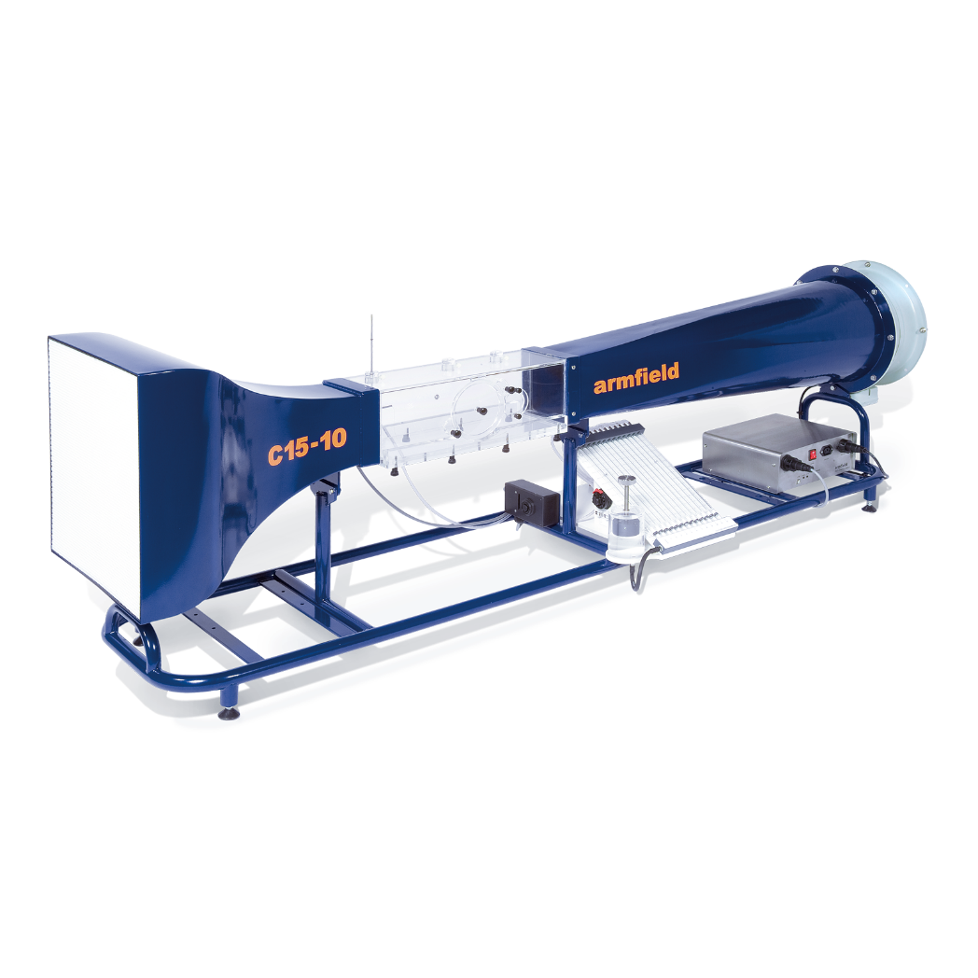
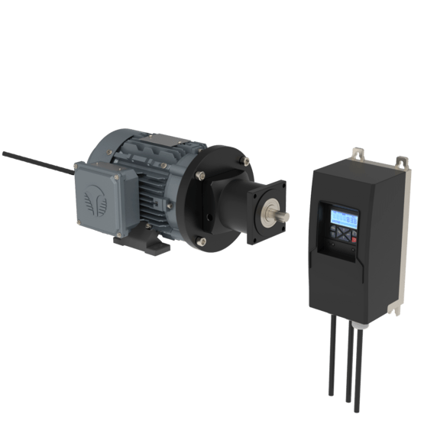
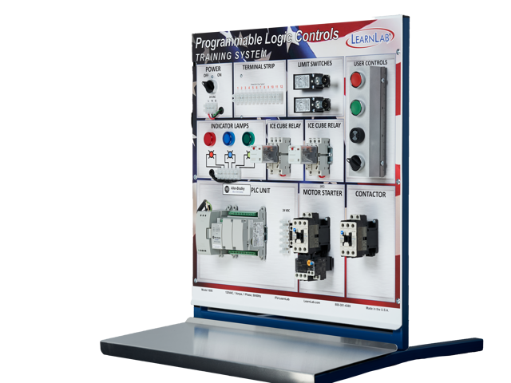
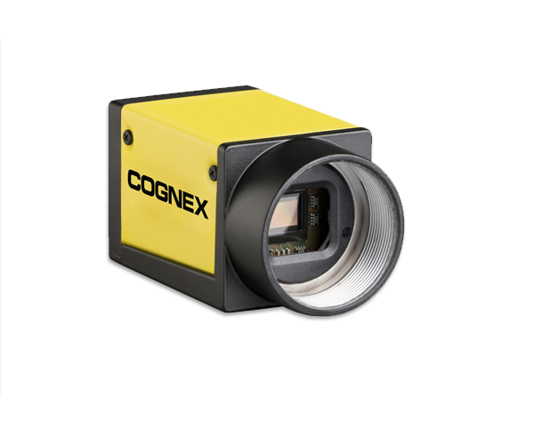
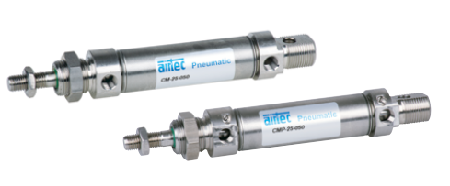
Project Objective(s)
Our group is tasked with creating a PLC Trainer platform alongside 1 VFD/motor module, 1 wind tunnel module, 1 pneumatic piston module, and 1 Cognex camera module to teach various aspects of PLC control for the upcoming automation and control class.

Slide 3
Scope
Must Be Part of the Scope | Stretch Goals | Task Outside of the Scope
1 PLC trainer platform (control panel, HMI, buttons, switches, indicators, compatible with industry regulations, has examples of sinking and sourcing for input and output devices, analog and digital I/O, serial communication, network communication, wiring diagram) 1 wind tunnel module to teach analog sensing and control (P&ID, wiring diagram, set point control +- 10% errors: volumetric flow rate control TBD & air temperature control TBD) 1 VFD & motor module to teach network and serial communications (P&ID, wiring diagram) 1 Pneumatic switch module to teach digital sensing and control (P&ID, wiring diagram) 1 Cognex camera module to teach network and serial communications (Integration: position/ orientation & color) Documentation/drawings/bill of materials to reproduce product | Advanced Cognex camera integration (defect detection, barcode reading, gliff registration) Interaction/ communication with lab robot arms | Additional modules Senior design lab copy Additional units of the trainer and modules for the class

Slide 4
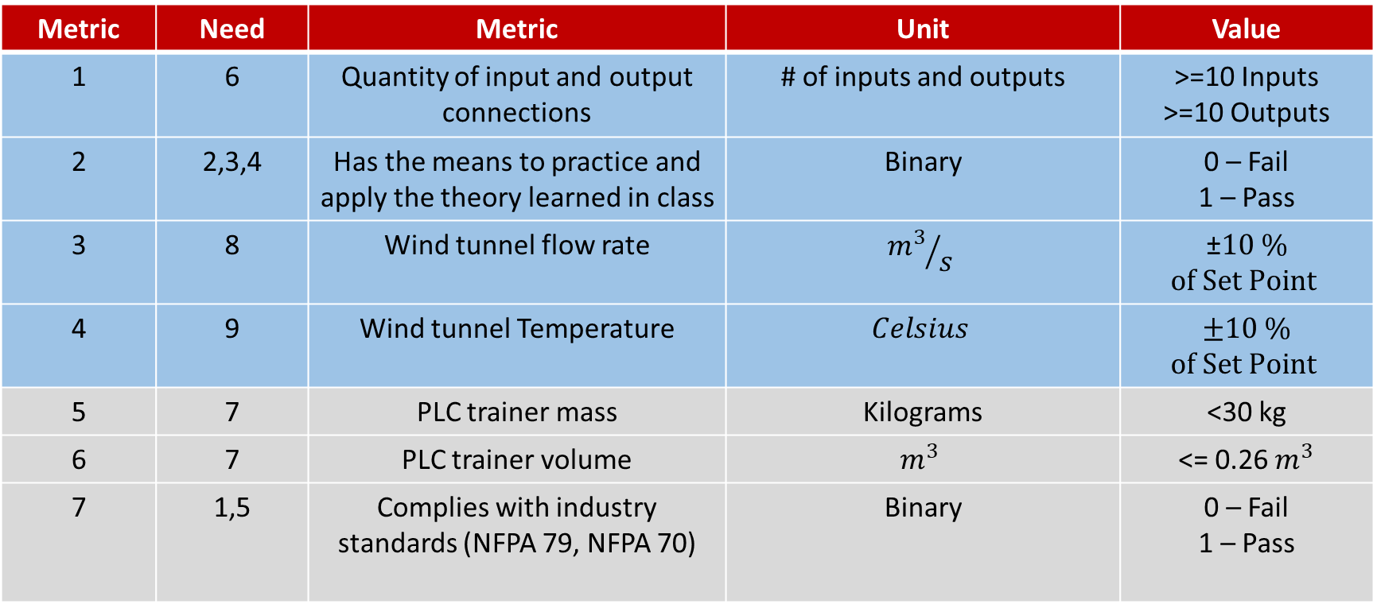
Design Metrics
Metric | Need | Metric | Unit | Value
1 | 6 | Quantity of input and output connections | # of inputs and outputs | >=10 Inputs >=10 Outputs
2 | 2,3,4 | Has the means to practice and apply the theory learned in class | Binary | 0 – Fail 1 – Pass
3 | 8 | Wind tunnel flow rate | $${m^{3}}/s$$ | ±$10 \%$ $of Set Point$
4 | 9 | Wind tunnel Temperature | $$Celsius$$ | $±10 \%$ $of Set Point$
5 | 7 | PLC trainer mass | Kilograms | <30 kg
6 | 7 | PLC trainer volume | $$m^{3}$$ | <= 0.26 $m^{3}$
7 | 1,5 | Complies with industry standards (NFPA 79, NFPA 70) | Binary | 0 – Fail 1 – Pass

Slide 5
Current Progress
Research has been the major priority since the start of the project
Quinton has been giving us lectures on different PLC aspects
Communications with PLCs
Digital and analog I/O
PLC basics
The team has separated into sub-groups to focus on research of each module.
Pneumatic pistons
Variable frequency drive and motors
Wind tunnels

Slide 6
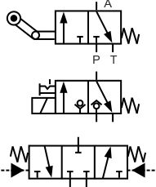
Current Progress
Progress on pneumatic pistons module:
The pneumatic piston is designed to showcase digital input and output interaction with the PLC device
We have begun to look at current off-the-shelf components to better understand how to design with their properties in mind
Pneumatic cylinder standards: NFPA, ISO
Direction control valve diagrams
Parts:
Pneumatic Cylinder
Direction control solenoid valve
Tubes
Fittings
Manifold

Slide 7
Current Progress
Progress on the wind tunnel module:
The wind tunnel module is designed to showcase analog inputs and outputs on the PLC device via set point temperature and flow rate control
We have begun to look at current off-the-shelf components to better understand how to design with their properties in mind
Blowers (AC vs DC)
Temperature sensors (RTDs vs Thermocouples)
Heating element options (power requirements, materials)
Flow sensors (pitot static tube, orifice flow meter, anemometer)
Material considerations
Safety considerations

Slide 8
Current Progress
Progress on variable frequency drive (VFD) and induction motor
The VFD and induction motor are designed to showcase network and serial communications with the PLC, as long as digital I/O and analog I/O control of the VFD
A motor and VFD has been picked by the project advisors
Research has been done to understand how to wire the PLC to the VFD and the VFD to the motor

Slide 9
Technical Issues / Difficulties / Questions
We have concerns about the timeline of deliverables
Expected working components by the end of this semester:
Wind tunnel module
Pneumatic piston module
Variable frequency drive module
PLC trainer platform
Expected working components by the end of next semester:
Cognex camera module
Interaction with lab robots

Slide 10
Plans
Go in depth on the agreed upon design between all team members
Create detailed CAD designs for each module
Create P&ID diagrams for each module and the trainer platform
Create initial wiring schematics for each module and trainer platform
Start sourcing and ordering parts for each component of the module and platform

Slide 11
Questions?

